Slide 1
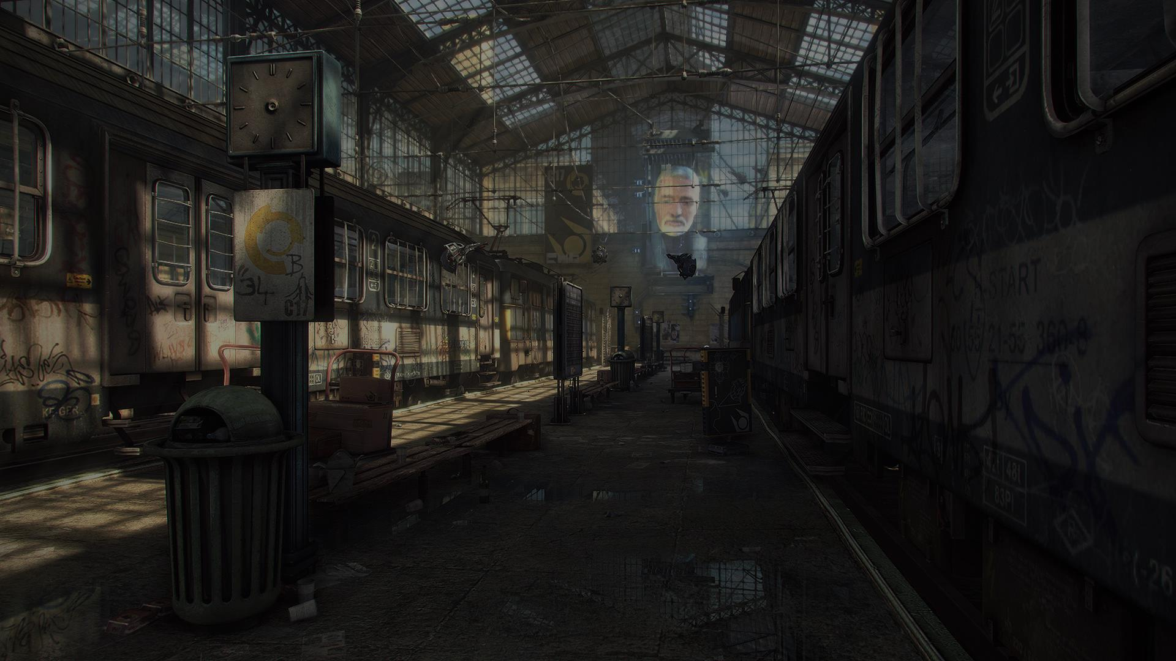

Somatic Mod For Half-Life 2
Ian Colquhoun

Slide 2


Slide 3
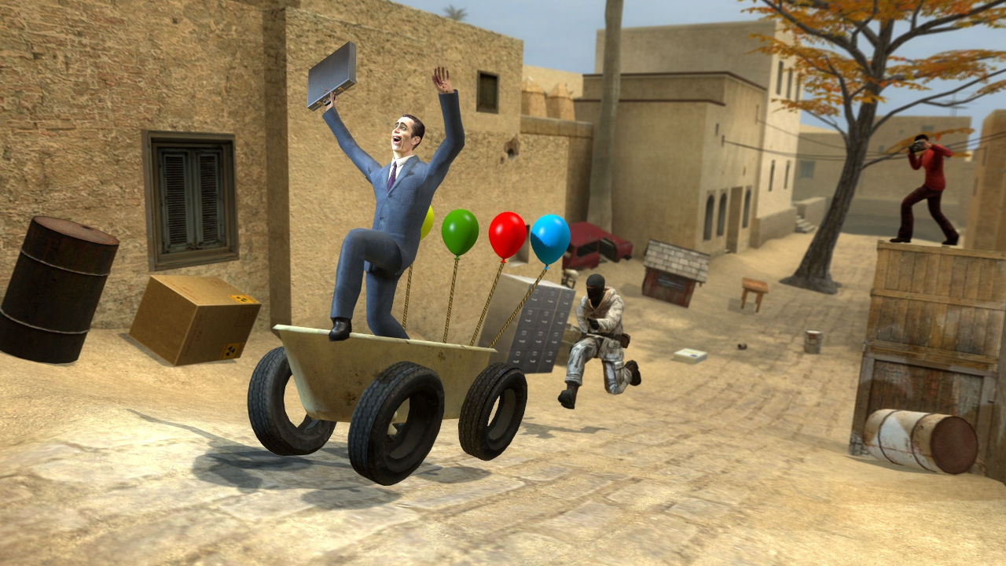

Slide 4
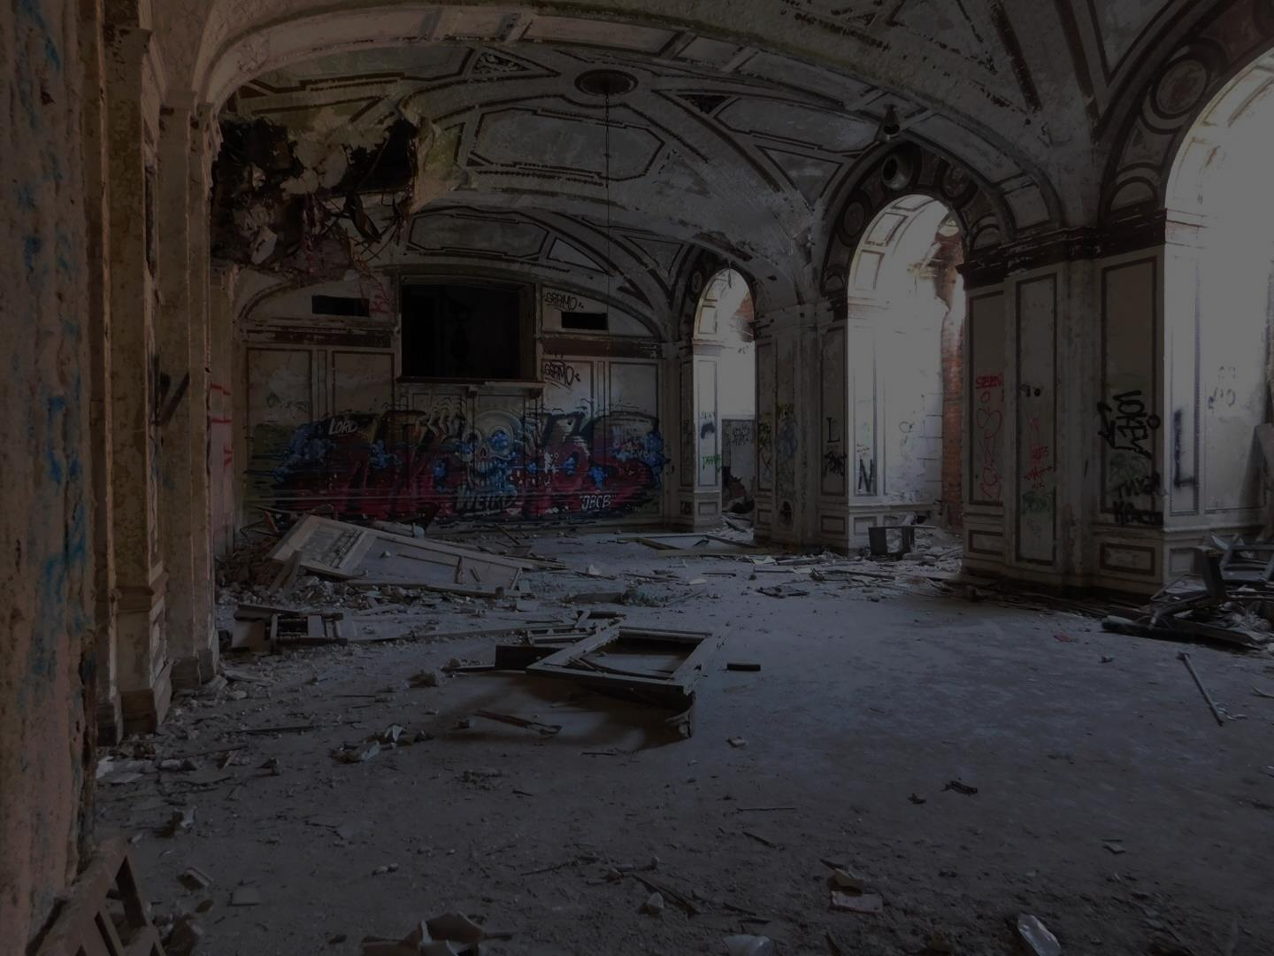
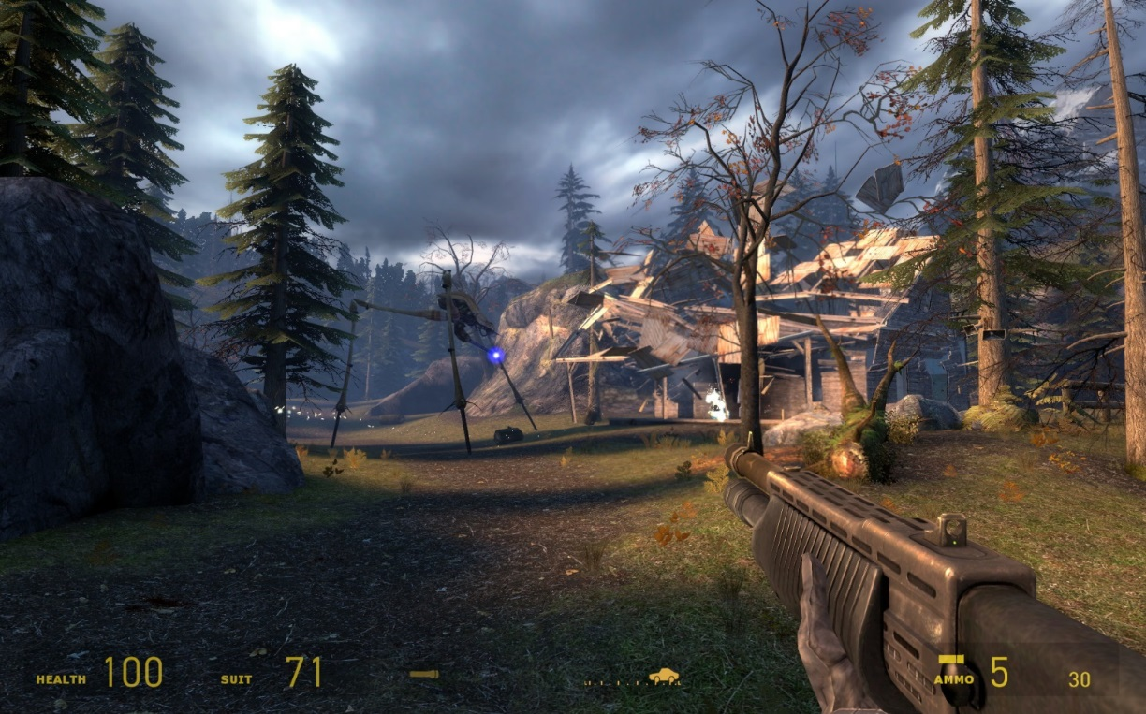
WHAT IS IT?

Slide 5
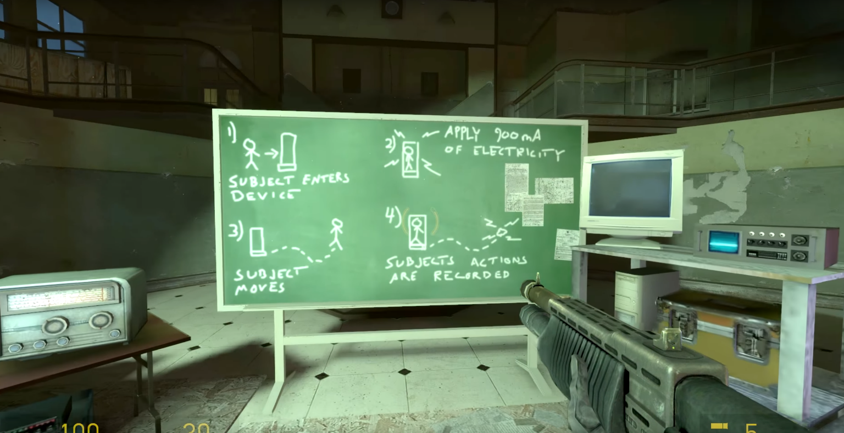
WHAT IS IT?

Slide 6
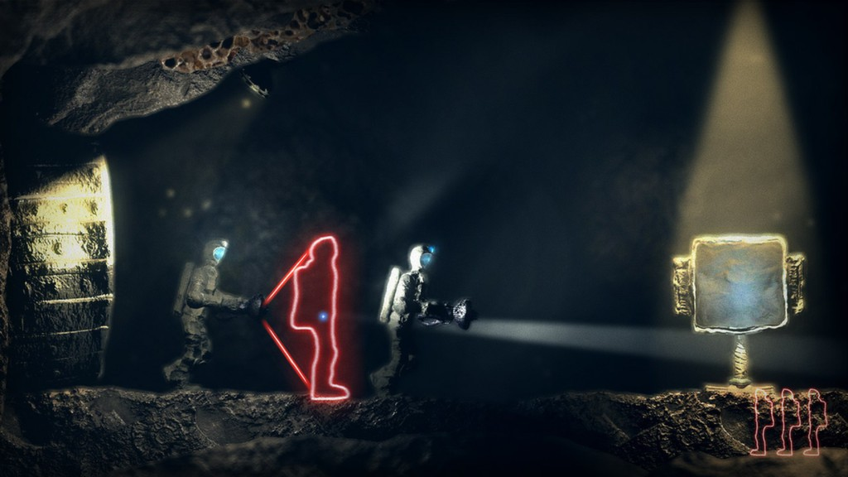
WHAT IS IT?

Slide 7
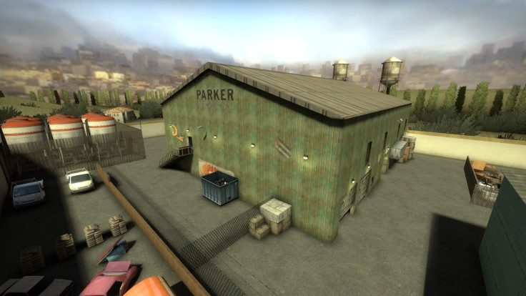
THE PLAN

Slide 8
THE PLAN
Release for free on Steam Workshop

Slide 9
THE PLAN
Release for free on Steam Workshop
Level design portfolio

Slide 10
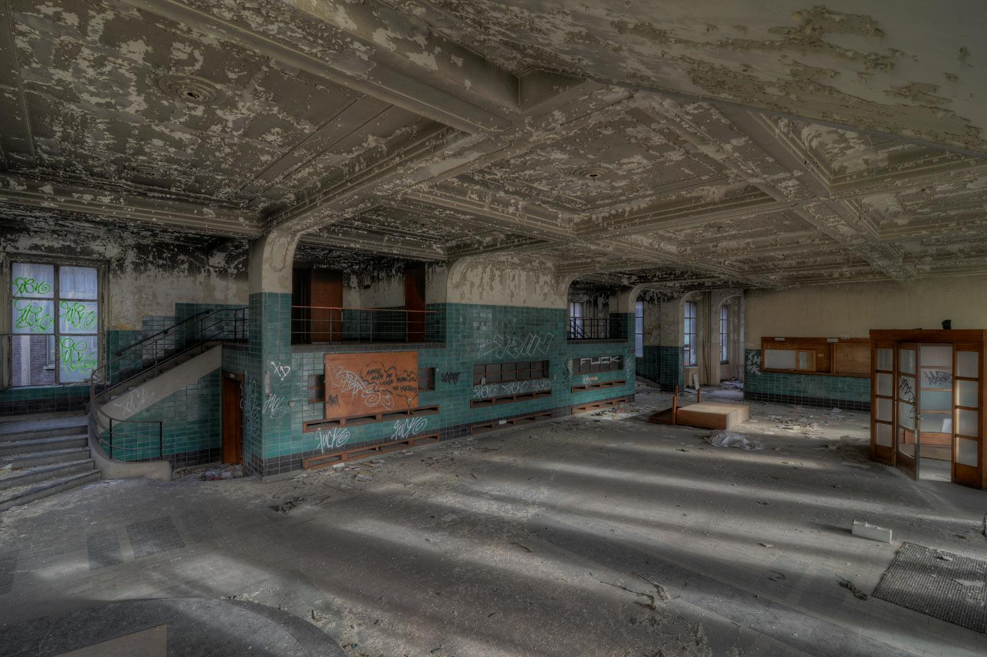
LEGAL CONSIDERATIONS

Slide 11
LEGAL CONSIDERATIONS
Uses HL2 assets

Slide 12
LEGAL CONSIDERATIONS
Uses HL2 assets
Released for non-profit

Slide 13
LEGAL CONSIDERATIONS
Uses HL2 assets
Released for non-profit
Valve supports fan content

Slide 14

LEGAL CONSIDERATIONS
Uses HL2 assets
Released for non-profit
Valve supports fan content

Slide 15
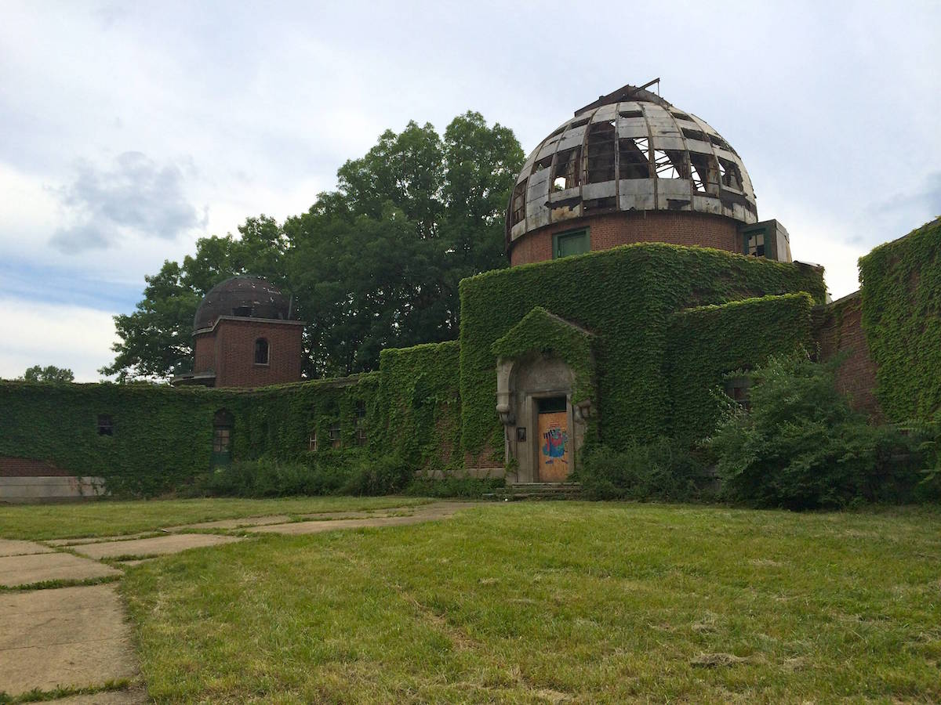
DEVELOPMENT SCHEDULE

Slide 16
DEVELOPMENT SCHEDULE
For ~15-minute level:

Slide 17
DEVELOPMENT SCHEDULE
For ~15-minute level:
Mechanic prototype: 2 weeks

Slide 18
DEVELOPMENT SCHEDULE
For ~15-minute level:
Mechanic prototype: 2 weeks
Level greybox: 1 month

Slide 19
DEVELOPMENT SCHEDULE
For ~15-minute level:
Mechanic prototype: 2 weeks
Level greybox: 1 month
Art pass: 1 month

Slide 20
DEVELOPMENT SCHEDULE
For ~15-minute level:
Mechanic prototype: 2 weeks
Level greybox: 1 month
Art pass: 1 month
Testing/polish: 2 weeks

Slide 21
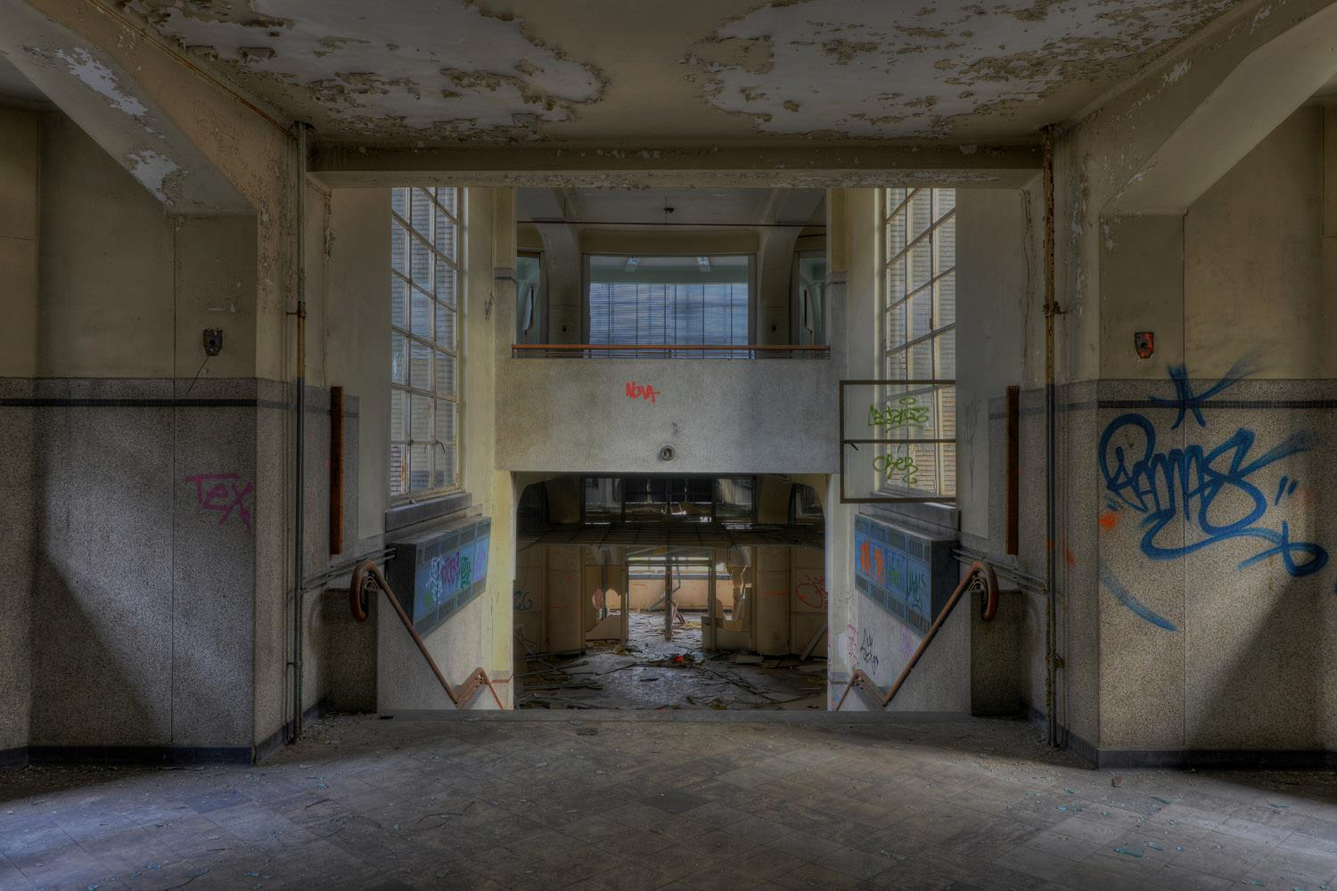
THE TEAM

Slide 22
THE TEAM
Coder

Slide 23
THE TEAM
Coder
Sound guy

Slide 24
THE TEAM
Coder
Sound guy
2D/3D artist

Slide 25
THE TEAM
Coder
Sound guy
2D/3D artist
This is scalable!

Slide 26
THE TEAM
Coder
Sound guy
2D/3D artist
This is scalable!
Mentor: Brad (or Mike)

Slide 27
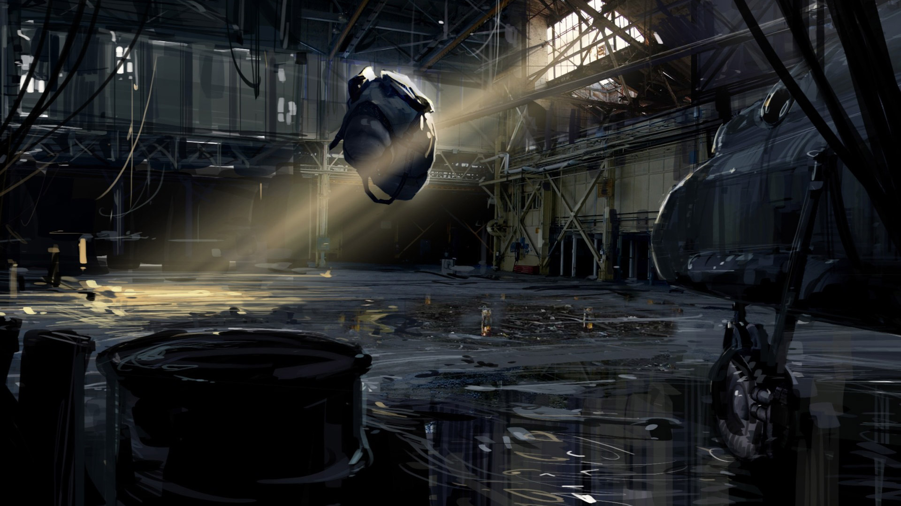
Thank you!

